Slide 1
Voice Assistant News WebApp
Here is where your presentation begins

Slide 2
Team Member
Raj Navadiya
Vatsal Panchani
Prof. Sandeep R. Suthar
Dr. Vipul K. Dabhi
IT 6th sem, DDU
IT 6th sem, DDU
Faculty
Co-ordinators
Assistant Professor, IT Dept, DDU
HOD, IT Dept, DDU

Slide 3
01
Introduction
02
Tech Stack
TABLE OF CONTENTS
03
Flow
04
Challenges
Basic introduction aloing with purpose to make it.
Technologies we used to develop this web app.
How our website works.
Problem we faced during development.

Slide 4
ONLINE NEWS APP
Visitors can see News Worldwide and Reporters Can post their News . Users can Listen News by Voice Assistant.

Slide 5
01
Introduction
Basic introduction aloing with purpose to make it.

Slide 6
Introduction
News portal is a web-app which is useful for any user and for view and listen news is free of cost for all visitors.
This portal is provide news posting functionality for media reporter who can post their own news and for post the news subscription is required.

Slide 7
Tech Stack
02
Technologies we used to develop this web app.

Slide 8
Tech Stack
React JS
Tailwind CSS
Mongo DB
Node JS
Used for developing the website.(FrontEnd)
For providing better user interface and experience
DataBase to store all data
Used for developing the website.(BackEnd)

Slide 9
Flow of website
03
How our website works.

Slide 10
Flow for media reporter
Login/Register
View news
Post news
Media reporter Login required
Media reporter can view all news.
Media reporter must have to subscribed.

Slide 11
Flow for Visitor
Login/Register
View news
Listen news
Visitor Login required
Visitor can view all news.
Visitor can listen news.

Slide 12
Challenges
04
Problem we faced during development.

Slide 13
Challenges we tackled
React JS
Alan AI
React js was completely a new technology for us. We learned it and create this website
It was not working with some version of react js. So we have changed our version to make compatible with alan ai.

Slide 14
Highlights
05

Slide 15
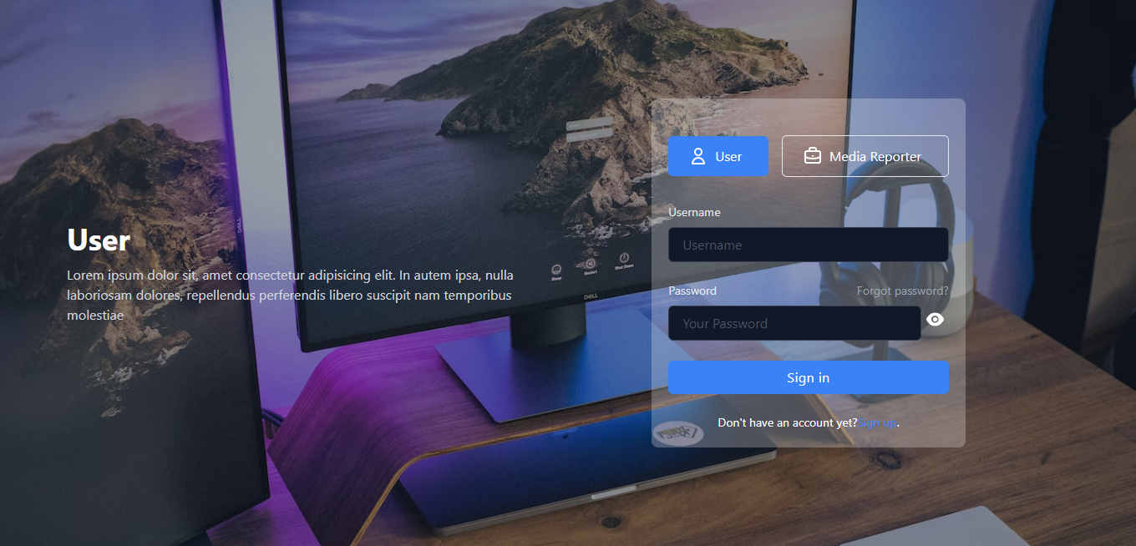

Slide 16
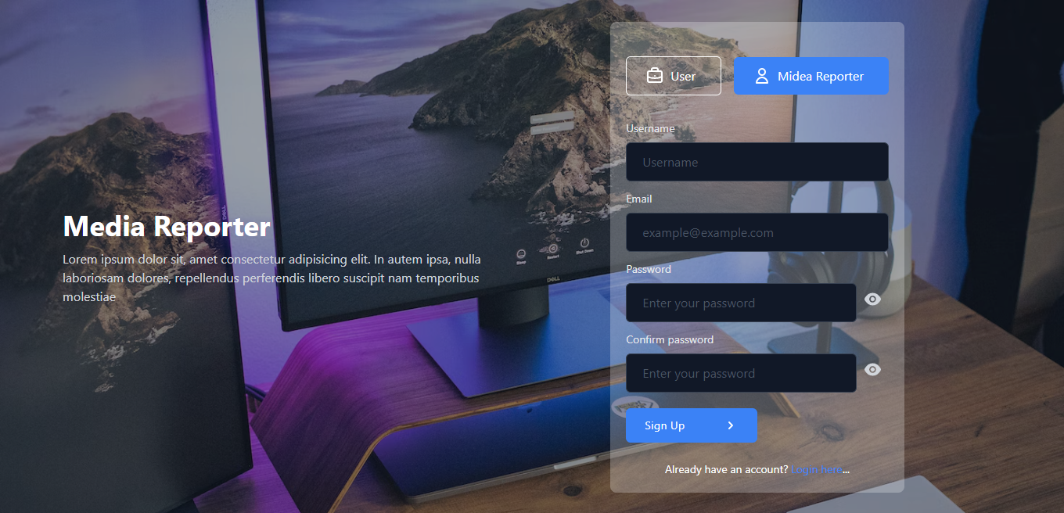

Slide 17
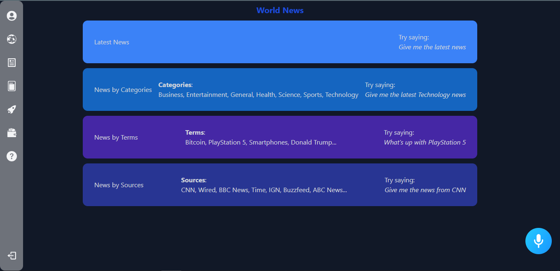

Slide 18
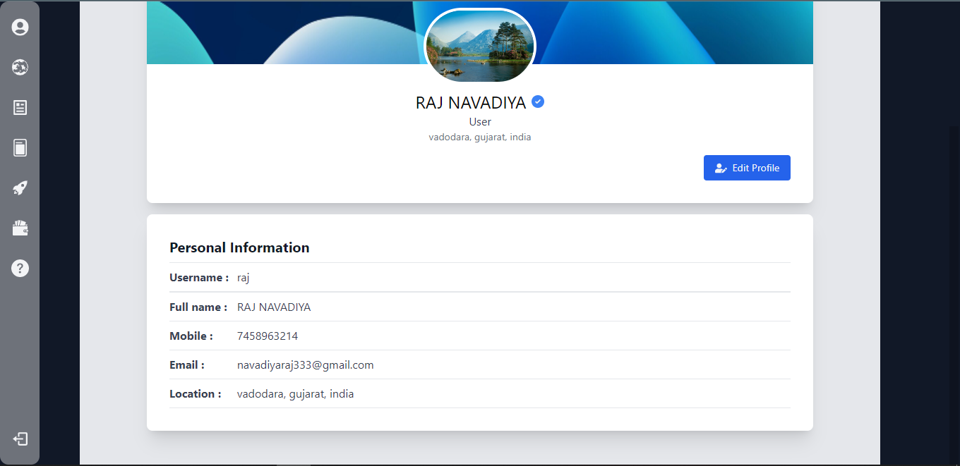

Slide 19
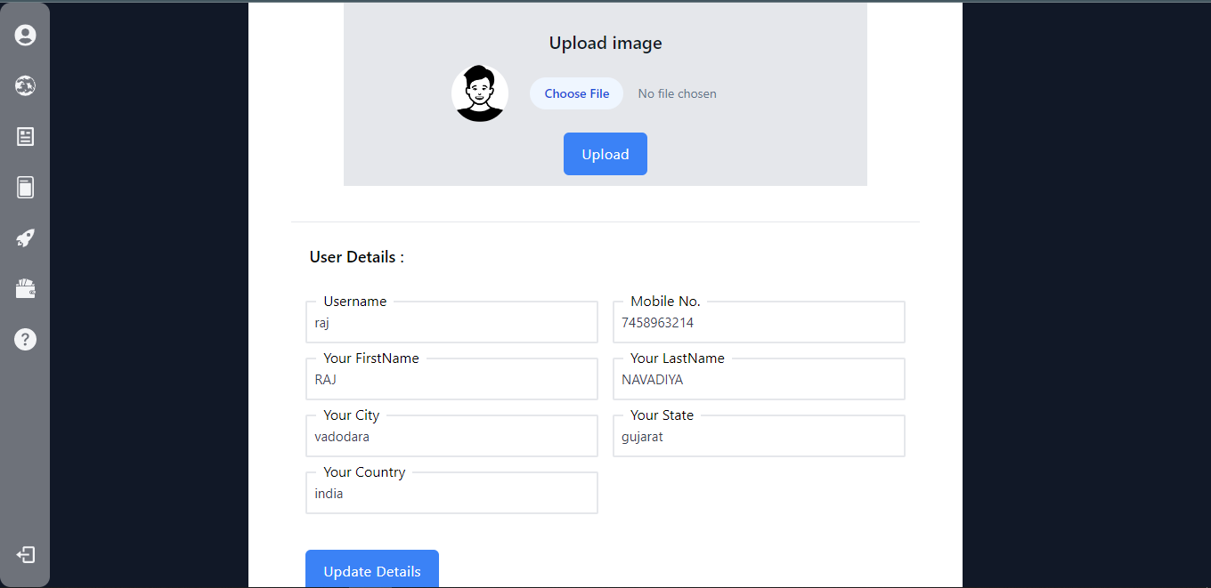

Slide 20
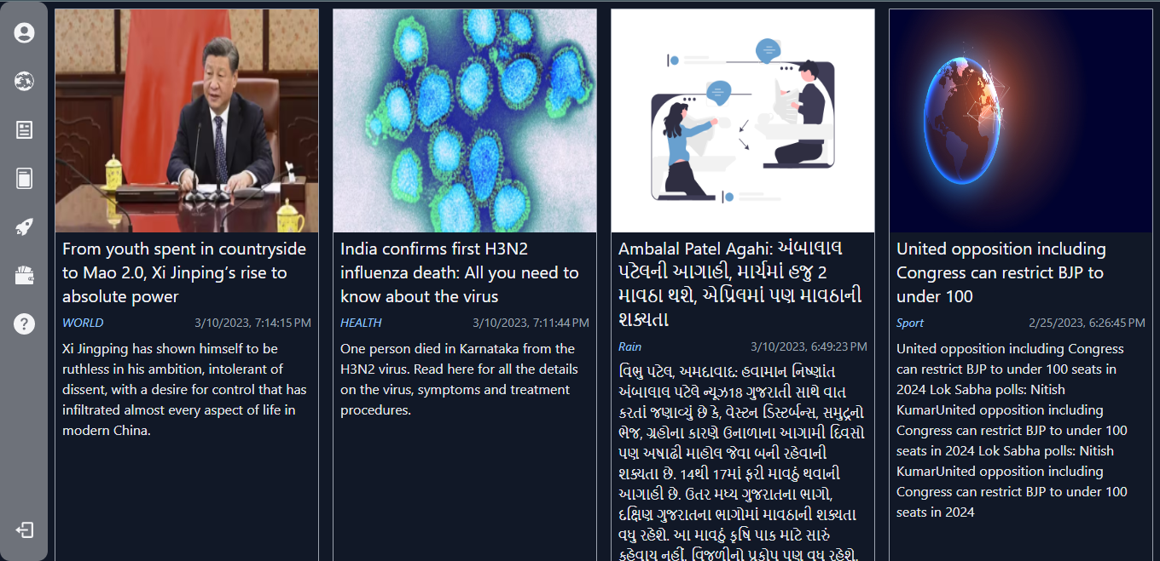

Slide 21
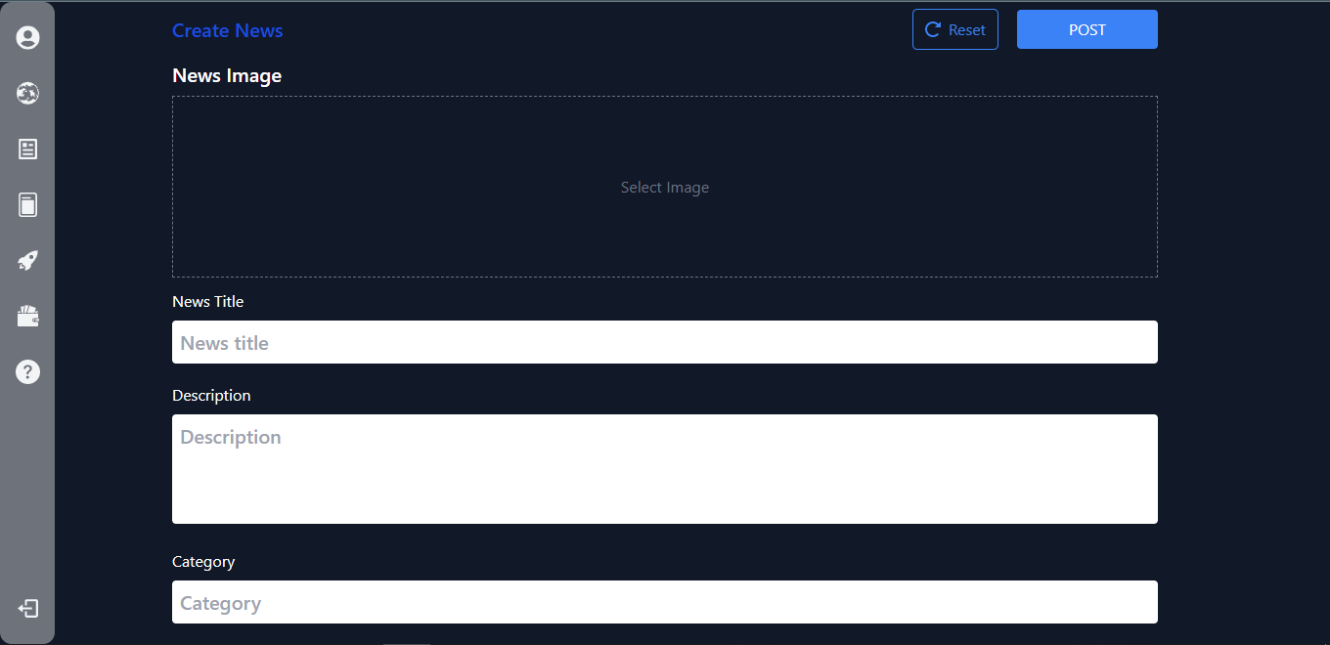

Slide 22
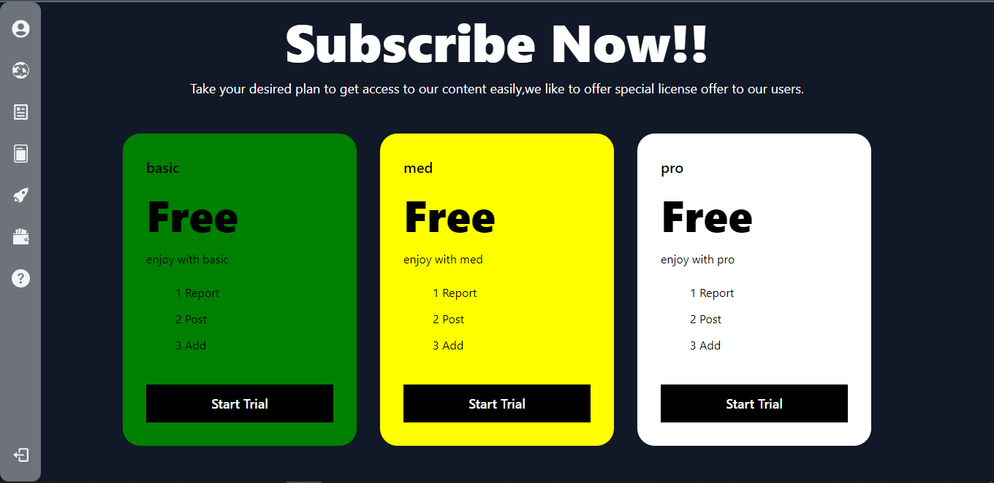

Slide 23
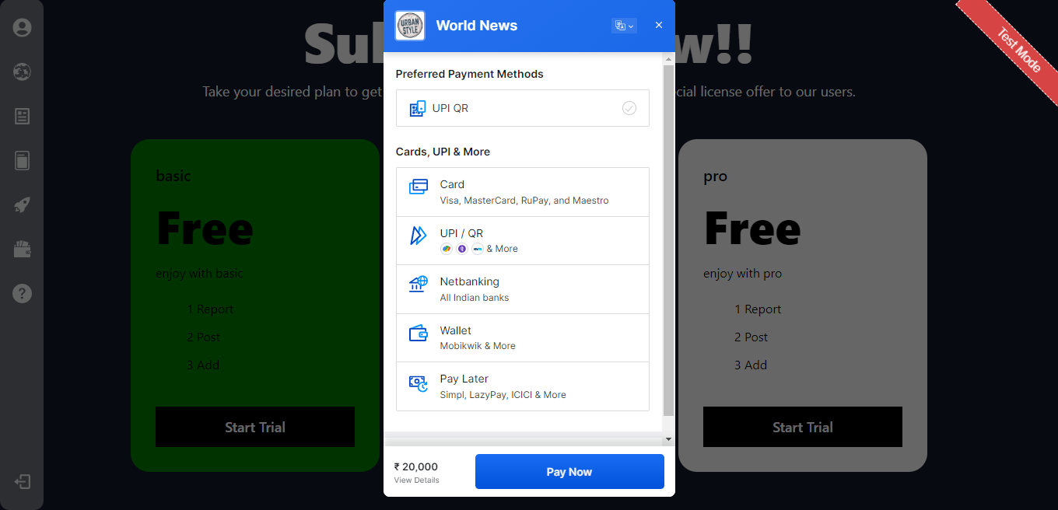

Slide 24
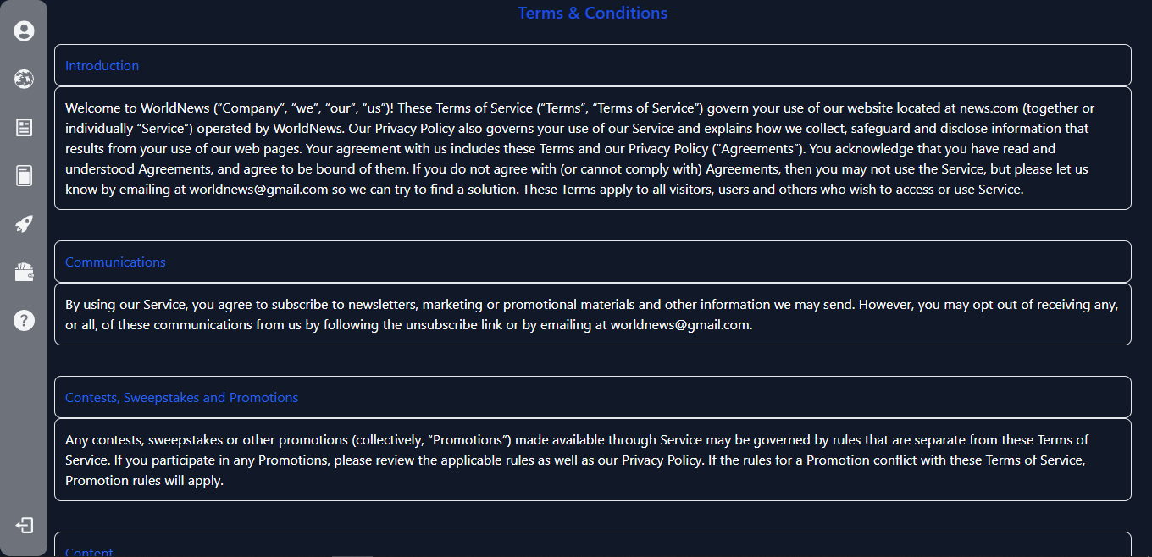

Slide 25
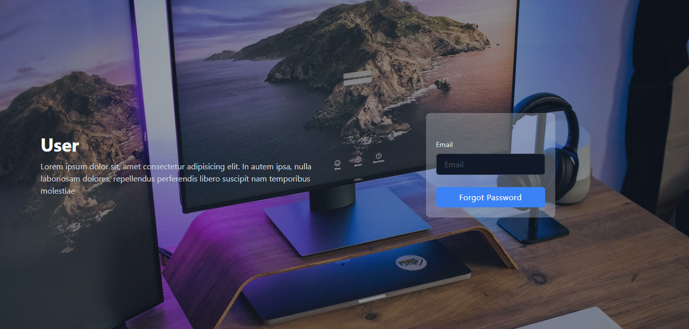

Slide 26
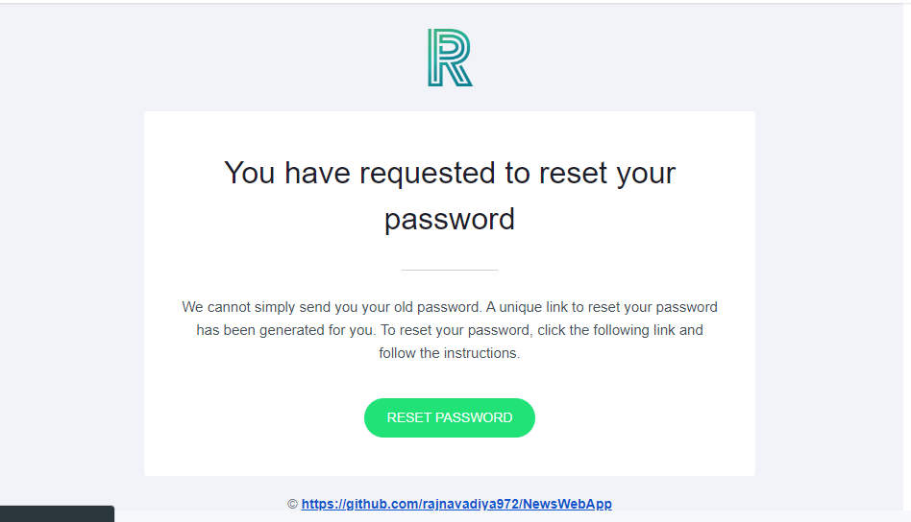

Slide 27
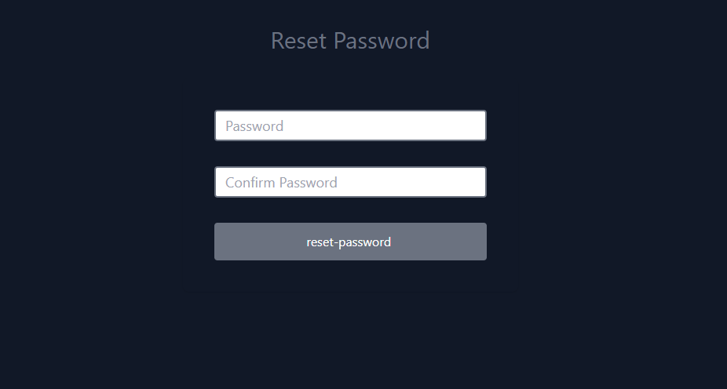

Slide 28
Thanks
Project Prepared by:
IT079 – Navadiya Raj
IT084 – Panchani Vatsal

